Slide 1
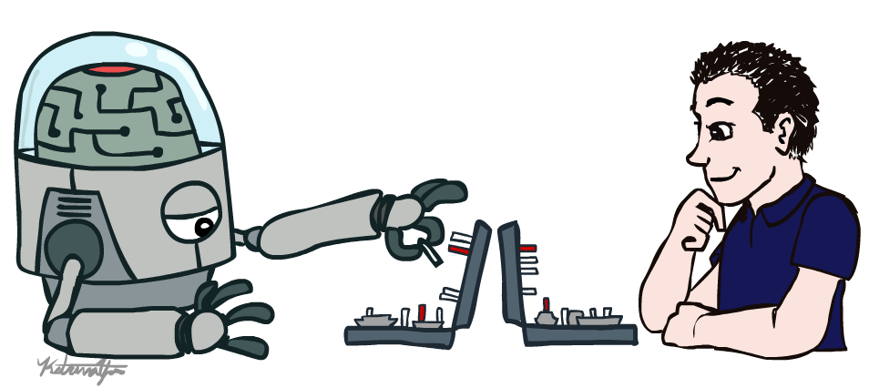
Fundamentals of Artificial Intelligence
Introduction
Instructor: Dr. Hatim Alsuwat
Umm Al-Qura University

Slide 2
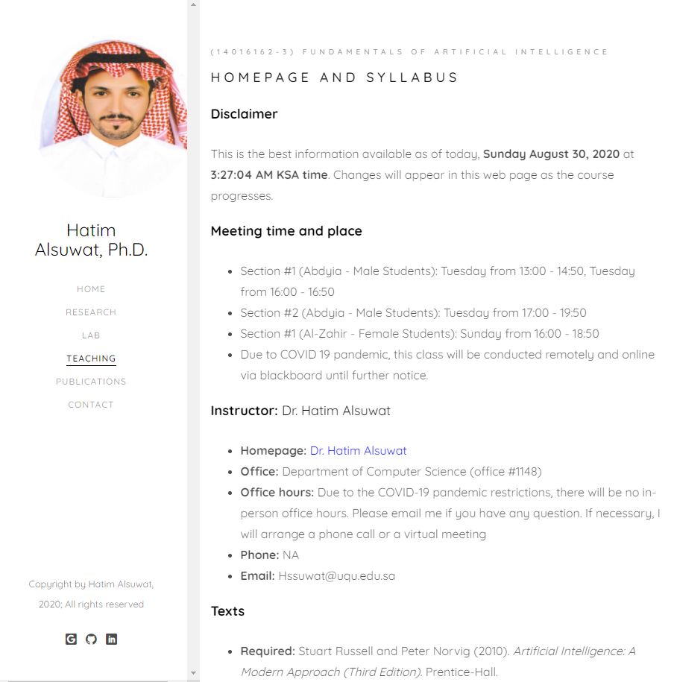
Course Information
https://hatimalsuwat.github.io/AI.html
Communication:
Announcements on webpage/ emails/ blackboard
Questions? Email me.
Staff email: hssuwat@uqu.edu.sa
Course technology:
Website
UQU Blackboard
Autograded projects.
interactive homework
Regular homework
Help us make it awesome!

Slide 3
Course Information
Course Website https://hatimalsuwat.github.io/AI.html
Discussion:
Please ask any question during the lecture (don’t be shy)
There is no such thing as a stupid question.
Answer others’ questions - if you know the answer ;-)
Learn from others’ questions and answers

Slide 4
Course Information
Prerequisites:
Required: Data Structures and Algorithms
There will be a lot of math and programming
background in data structures and algorithms, linear algebra, and
probability will all be helpful.
You should be prepared to review basic probability on your own if it is
not fresh in your head.

Slide 5
Course Information
Assignments:
Quizzes: there will be several quizzes randomly given
Homework assignments: there will be several homework assignments during the semester.
Group Project: 5 programming projects: Python, groups of 1 or 2
(Programming Language: Course programming projects will be in Python.)
Research project: Develop a Research Question, Find Sources: Reading and Note Taking, Evaluate Sources, Establish a Working Bibliography, Prepare to Write: Consider Audience and Purpose, Put It All Together.
Exams: One Midterm Exam and One Final Exam. Closed book tests will cover the course material.
Assignments are always due on the announced day and time. There will be a late submission penalty of 20%/day after the due date for homework and project assignments unless it is approved by the instructor. Cutoff date for assignments is 5 days after due date! Exams must be taken as scheduled except in cases of extenuating circumstances such as a documented emergency.
Participation can help on margins

Slide 6
Course Information
Grading:
Midterm Exam: 20%
Projects:10%
Homework Assignments: 10%
Research project: 15%
Quizzes: 5%
Final Exam: 40%
Total score that can be achieved: 100

Slide 7
Course Information
Meeting time and place:
Office: Department of Computer Science (office #1148)
Office hours: Due to the COVID-19 pandemic restrictions, there will be no in-person office hours. Please email me if you have any question. If necessary, I will arrange a phone call or a virtual meeting
Email: Hssuwat@uqu.edu.sa

Slide 8

Textbook
Not required, but for students who want to read more we recommend
Russell & Norvig, AI: A Modern Approach, 3rd Ed.
Warning: Not a course textbook, so our presentation does not necessarily follow the presentation in the book.

Slide 9
Acknowledgements
Dan Klein
Pieter Abbeel
Stuart Russell
Brad Miller
Nick Hay
John DeNero
Pooyan Fazli

Slide 10
Course Information: Feedback
Please give feedback positive or negative as early as you can via email.

Slide 11
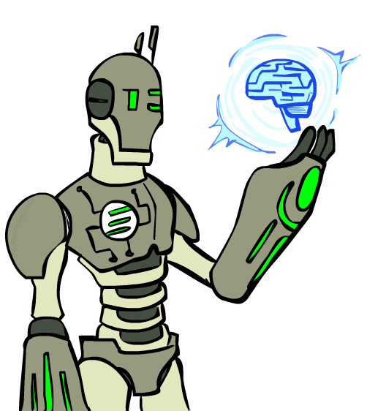
Today
What is artificial intelligence?
What can AI do?
What is this course?
Notes:
What are we going to look at today in the term of artificial intelligence? We are looking at what it is? What is this course really about?
What is AI?
What can AI do for us?
And what is exactly is going to be in this course?

Slide 12
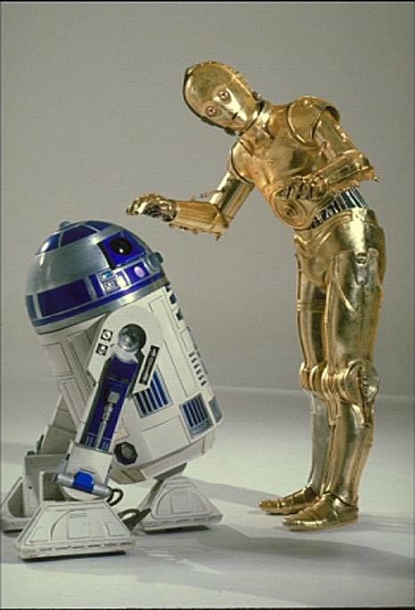
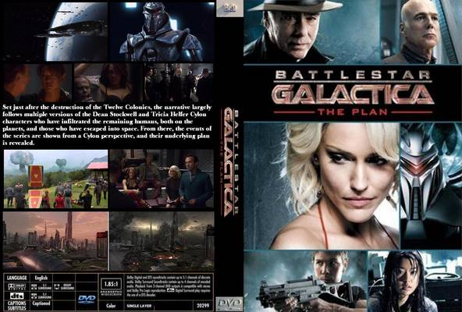
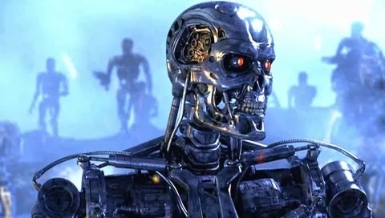
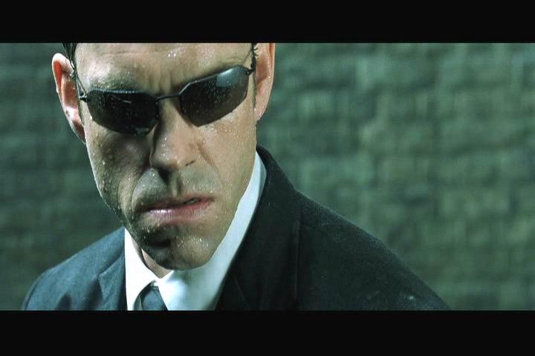
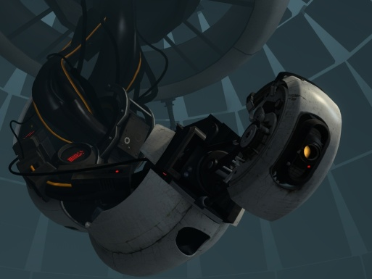
Sci-Fi AI?
Notes:
Who are these? C3PO, what does he do? Essentially google translate, (but with anxiety disorder!)
Smal guy? R2D2 – what does he do, yeah, not so sure
Things got darker: machines come back from the future – to kill us!
90’s : software is scary
Basic fear about what technology might do ?
What if we can’t even tell technology apart from ourselves?
OR maybe it’ll look really different and snarky
Some exceptions like wall-E, positive view of technology (but maybe not of us humans!)
But mostly a worry
[not very worried myself, at least at present]

Slide 13
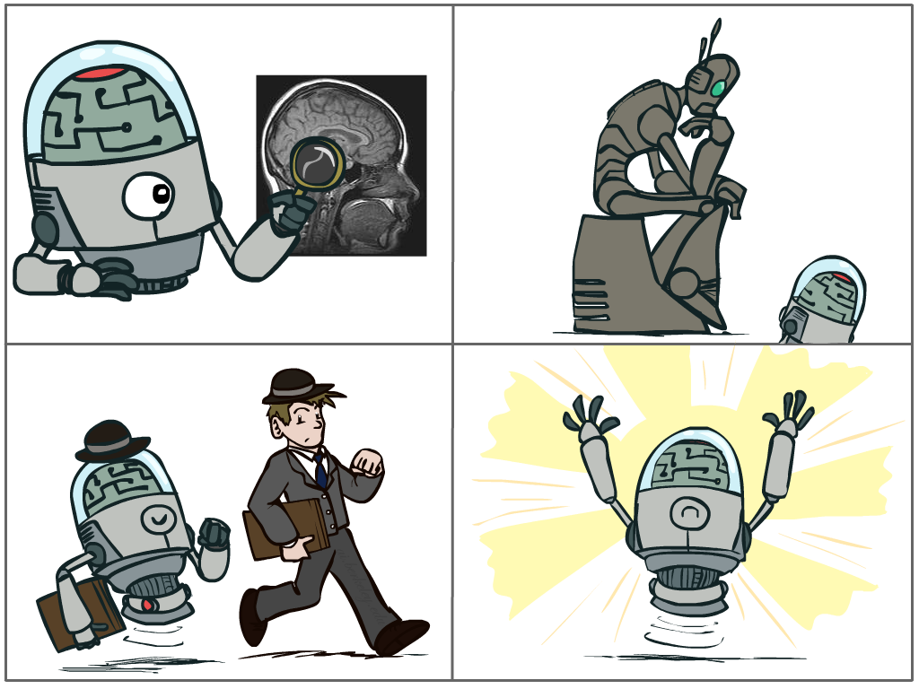
What is AI?
The science of making machines that:
Think like people
Think rationally
Act like people
Act rationally
Notes:
# What are we going to look at? We are going to look at a science of making machines that do something. We mean that a machine that:
Thinking like people: a way to do this is to study the brain. We use our brains to think. If you can understand how the brain works, then you will be able to build an intelligent machine.
People are still working on this field and it is very difficult field. It is not what we are going to look at, but it is an important field that people are working on.
# Another way to define AI would be to say about acting like people: that should be something that came up very early on and early days of AI. Actually, it is a very early definition of AI, dating back to Alan Turing 1950. Alan Turing proposed the Turing Test. The idea of the Turing test is ( if you can not distinguish a machine from a person then you pass the Turing test). For example: A computer passes the test if a human interrogator, after
posing some written questions, cannot tell whether the written responses come from a person
or from a computer. (online chat session )
The computer would need to possess the following capabilities:
1- natural language processing to enable it to communicate successfully in English;
2- knowledge representation to store what it knows or hears;
3- automated reasoning to use the stored information to answer questions and to draw new conclusions;
4- machine learning to adapt to new circumstances and to detect and extrapolate patterns.
A problem of acting like people is that you start focusing on things like don’t answer too quickly what the square root of 1412 is(no way that a person answer you very quickly) , don’t spell too well, and make sure you have a favorite movie etc. So that does not get us anywhere. So it wasn’t really leading us to build intelligence. We want to build an AI to help us not to look like us.
#Think rationally – long tradition dating back to Aristotle --- but not a winner, because difficult to encode how to think, and in the end it’s not about how you think, it’s about how you end up acting
# Here in this course we are going to follow the last one which has the most impact so far and the goal here is to make something acts rationally.
Acting rationally means act in a way that maximize your chances to achieve your goals. And a person might specify the goal to the machine and say Machine your goals such and such and then the machine act rationally and maximize these chances to keep this goals. This is the raw idea.

Slide 14
Rational Decisions
We’ll use the term rational in a very specific, technical way:
Rational: maximally achieving pre-defined goals
Rationality only concerns what decisions are made
(not the thought process behind them)
Goals are expressed in terms of the utility of outcomes
Being rational means maximizing your expected utility
A better title for this course would be:
Computational Rationality
Notes:
Example of utilities. 10 for A, 1 for each Friday with friends
----------------------------
**Lets break it down a little bit more..
*Rational means maximally achieving pre-defined goals.
* What is important here is to consider only what action it takes. It does not matter what the process is.
Every possible outcome, anything that could happen in your environment that you're looking in your system as a number associate with it. This number is called a utility. It measures how good an outcome is.
Maximizing your expected utility is going to be what our entire is about.
So an alternative title for this course would be Computational Rationality.

Slide 15
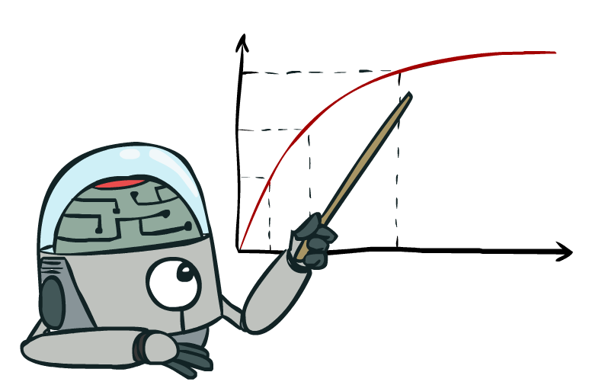
Maximize Your
Expected Utility

Slide 16
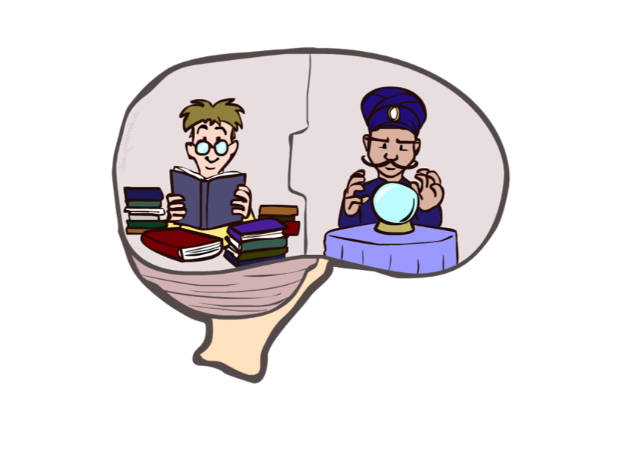
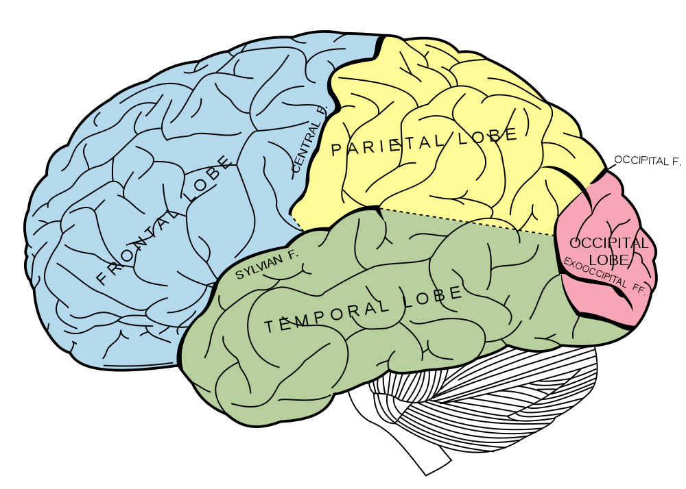
What About the Brain?
Brains (human minds) are very good at making rational decisions, but not perfect
Brains aren’t as modular as software, so hard to reverse engineer!
“Brains are to intelligence as wings are to flight”
Lessons learned from the brain: memory and simulation are key to decision making
Notes:
So what about the Brain?
# In the brain we have a functioning system there. It about 7 billion maybe this time. Most of them think cleverly than most computers. So should we look what the brain is doing and then build AI that way.
Some people try to do it that way but it is not the way that we are going to look at it in this course.
#Brains aren’t as modular as software, so hard to reverse engineer! So for example when you go to a restaurant and you like your dish, then when it is not hard to reverse engineer the dish you like.
But as we said Brains aren’t as modular as software, so hard to break it down.
# people say as a lesson learned “Brains are to intelligence as wings are to flight”.
We mean by this We didn’t reverse engineer birds to create airplanes. Instead we studied the mechanics of flight and used these principles to build wings.
Likewise, we don’t need to reverse engineer the brain to create AI. We ‘just’ need to understand the mechanics of intelligence and then we can build much faster and more powerful AIs.
# lessons we are learning in this class from the brain for AI:
Two things:
There is two ways that we make decisions at a high level:
1- one of them is based on memory: we have seen something before; it was successful before and then you are going to use this knowledge of being successful before. Then you are going to use this actions or remapping that action to the current situation. That is Machine Learning. And this what are we going to look at in the second half of the course.
2- another way we make decisions by simulating. We think a head. We say what if we were to study for this class. How many hours we want to study. So lets say studying might lead to higher grades. And this might to conclude. That’s the way to go.
This is going to be the first half of the course which simulating ahead, going to different scenarios in the computer then see which scenario is the best and then executing in this scenario.

Slide 17
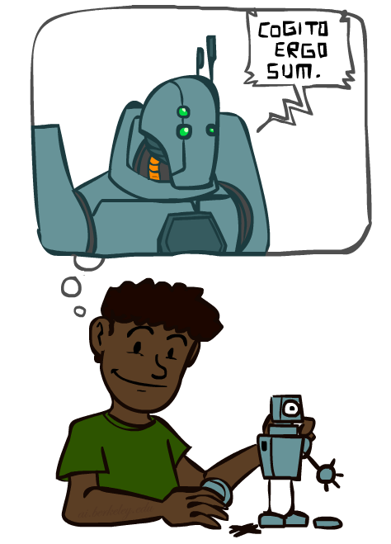
A (Short) History of AI
Demo: HISTORY – MT1950.wmv
Notes:
Before getting into that, lets see a short history of AI. Get a little of context of what people have done since the beginning of AI.

Slide 18

Notes:
Thinking machines video --- interviews from back when computers were in the very early years; starting to realize can do something else than arithmetic ; asking where things are headed; many famous people

Slide 19
A (Short) History of AI
1940-1950: Early days
1943: McCulloch & Pitts: Boolean circuit model of brain
1950: Turing's “Computing Machinery and Intelligence”
1950—70: Excitement: Look, Ma, no hands!
1950s: Early AI programs, including Samuel's checkers program, Newell & Simon's Logic Theorist, Gelernter's Geometry Engine
1956: Dartmouth meeting: “Artificial Intelligence” adopted
1965: Robinson's complete algorithm for logical reasoning
1970—90: Knowledge-based approaches
1969—79: Early development of knowledge-based systems
1980—88: Expert systems industry booms
1988—93: Expert systems industry busts: “AI Winter”
1990—: Statistical approaches
Resurgence of probability, focus on uncertainty
General increase in technical depth
Agents and learning systems… “AI Spring”?
2000—: Where are we now?
Notes:
1940-1950:
The first work that is now generally recognized as AI was done by Warren McCulloch and
Walter Pitts (1943). They drew on three sources: knowledge of the basic physiology and
function of neurons in the brain and Turing’s theory of computation. They proposed a model of artificial neurons
in which each neuron is characterized as being “on” or “off,”
1950- 70:
They were able to build a computer program that plays checkers. Also they were able to came up with a complete algorithm some mathematical proof making. Things were looking very good so far.
1970- early 90s:
people realized it is a lot harder than what they thought. An AI winter is a period of reduced funding and interest in artificial intelligence research. Example: failure of machine translation and collapse of the LISP machine market.
1990--: we saw researches of AI. Maybe we are now in AI spring. People getting very excited about AI and read article about AI system they are built.
So let see where are we now? Let see where were at. And what can be done now.

Slide 20
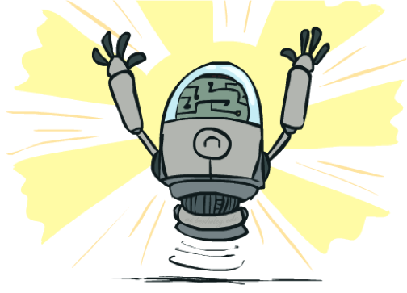
What Can AI Do?
Quiz: Which of the following can be done at present?
Play a decent game of table tennis?
Play a decent game of Jeopardy?
Drive safely along a curving mountain road?
Drive safely along Telegraph Avenue?
Buy a week's worth of groceries on the web?
Buy a week's worth of groceries at bin Dawood?
Discover and prove a new mathematical theorem?
Converse successfully with another person for an hour?
Perform a surgical operation?
Put away the dishes and fold the laundry?
Translate spoken Chinese into spoken English in real time?
Write an intentionally funny story?
Notes:
Which can be done now??
Drive safely along Telegraph Avenue?
It is very tricky to drive safely unless you go very slow and assume to get the people out of your way.
Discover and prove a new mathematical theorem?
Mixed answers.. My answer here why mixed? Well.. Two question are being asked here. One is proving: proving yes!! There have been systems that prove theorems that people had not been able to prove. And I think this is true. You ask the computer for a prove and the computer comes up with a prove. But Discovering is a different kind of game because there is a lot of statement in Math is true. For Example 1 + 1 =2 and so forth. So if you are not carefully, just has the computer discover something and prove it, It can discover so many things that is not useful. It is different when something is true and something is useful mathematical theorem.
That is something we need to make progress on.
Perform a surgical operation?
It mixed here. We have seen some robots that have done some surgical operations. But that systems and fully operator by the doctors in every single things.
Write an intentionally funny story? بقصد
Required the system to have the sense of humor. We are not there yet.

Slide 21
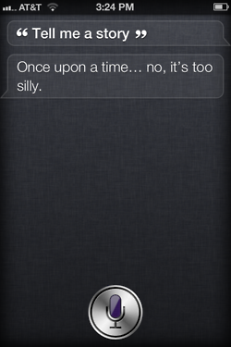
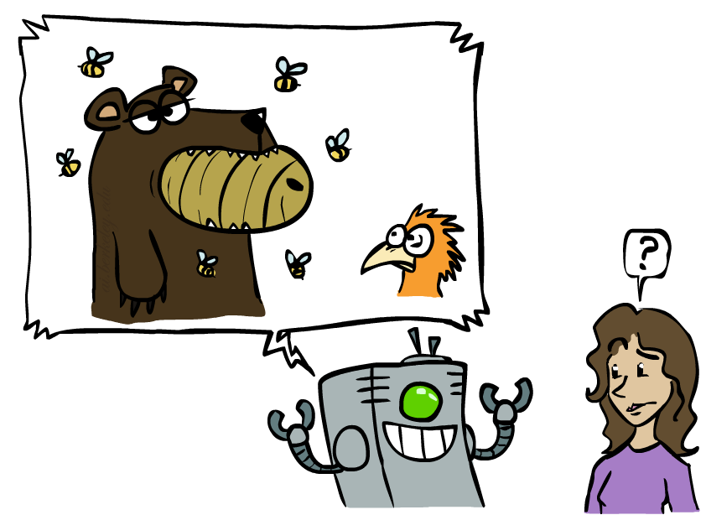
Unintentionally Funny Stories
One day Joe Bear was hungry. He asked his friend
Irving Bird where some honey was. Irving told him
there was a beehive in the oak tree. Joe walked to
the oak tree. He ate the beehive. The End.
Henry Squirrel was thirsty. He walked over to the
river bank where his good friend Bill Bird was sitting.
Henry slipped and fell in the river. Gravity drowned.
The End.
Once upon a time there was a dishonest fox and a vain crow. One day the crow was sitting in his tree, holding a piece of cheese in his mouth. He noticed that he was holding the piece of cheese. He became hungry, and swallowed the cheese. The fox walked over to the crow. The End.
[Shank, Tale-Spin System, 1984]
Notes:
Let's look at unintentionally funny stories::
What we are looking at here? This is a system by shank the tale-Spin system. People were trying to build an AI and make a progress in AI. So one way to make progress in AI is to think “what if the computer write a funny story in a meaningful way to us”. That is a challenge, and we can put it in the front of us and make a progress to it. (stories teach us a lesson about life)
So let's look at some stories generated by the system:
1 – (what is funny about this) a lot of things make sense, but then one thing does not make sense. And that’s what makes it so funny. physically wrong, shouldn’t eat beehive. This is not the way we eat the honey.
Next one: so close to be a funny story but one thing is not right. The system does not know how the world works.
2 – forgot that in drowning not the force is most important but the drownee. سحبته الجاذبيه تحت
3 – not physically wrong, not wrong in a language way, but wrong in the sense that it’s not aware of what is relevant to communicate and what is not
Siri – is that progress? About 30 years later.. Let see what we are doing.

Slide 22
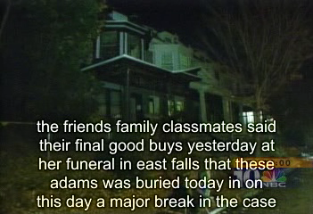
Natural Language
Speech technologies (e.g. Siri)
Automatic speech recognition (ASR)
Text-to-speech synthesis (TTS)
Dialog systems
Demo: NLP – ASR tvsample.avi
Notes:
NLP – ASR tvsample.avi
Natural language processing! Where are we?
Lets see Automatic speech recognition (ASR):
Mistake errors: good buys = should be goodbye Not prefect but not bad..
Text-to-speech synthesis (TTS): is a lot easer than ASR. Example: writtnig a text in google translator and let google translator read it.
Dialog systems: some simple dialog system exist. When you call somewhere and you don’t a person to communicate with you but you get a system.

Slide 23
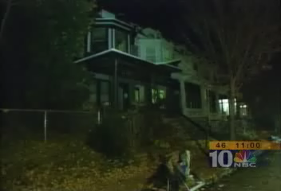

Slide 24
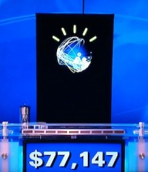
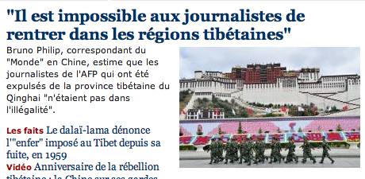
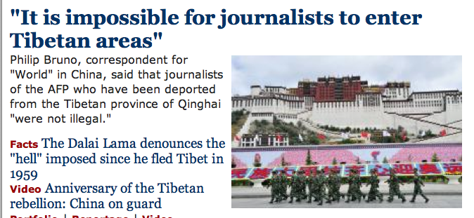
Natural Language
Speech technologies (e.g. Siri)
Automatic speech recognition (ASR)
Text-to-speech synthesis (TTS)
Dialog systems
Language processing technologies
Question answering
Machine translation
Web search
Text classification, spam filtering, etc…
Notes:
Other language processing technologies:
1- question and answering: there is a system can answer the questions effectively.
2- Machine translator. Like google translator even though it is not prefect but it is really useful.

Slide 25
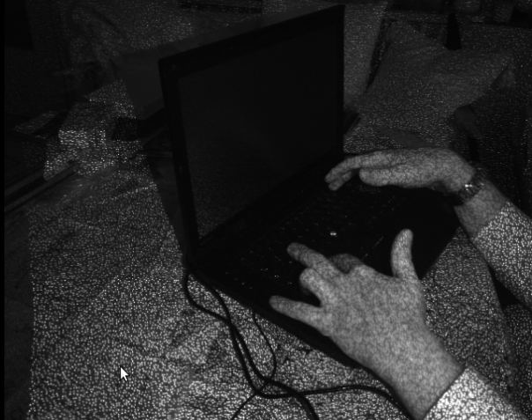
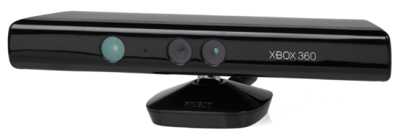
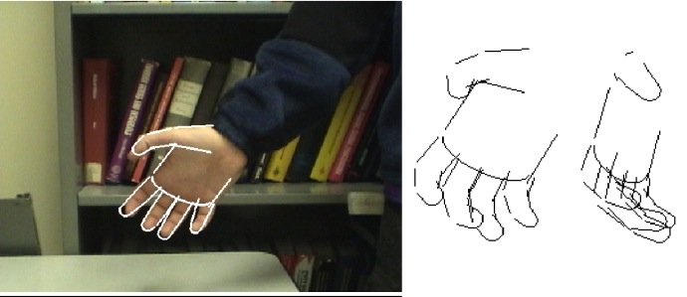
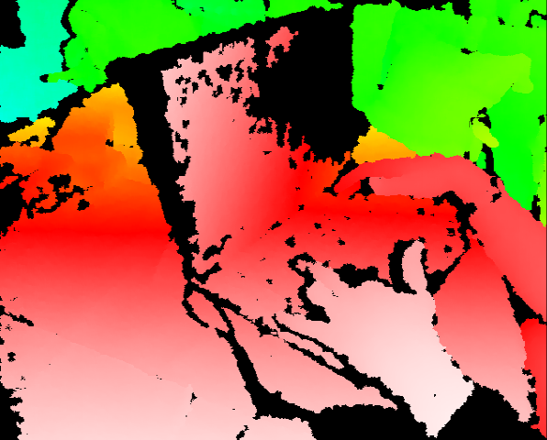
Vision (Perception)
Object and face recognition
Scene segmentation
Image classification
Demo1: VISION – lec_1_t2_video.flv
Images from Erik Sudderth (left), wikipedia (right)
Demo2: VISION – lec_1_obj_rec_0.mpg
Notes:
How about computer vision??
There is a lot of people working on computer vision these days.
What kind of system do we have? Ask the students..
Object and face recognition.. You have a lot of cameras that can recognize where the faces in the image. Not prefect accuracy but good systems exist.
Scene segmentation: The goal of segmentation is to simplify and/or change the representation of an image into something that is more meaningful and easier to analyze.

Slide 28
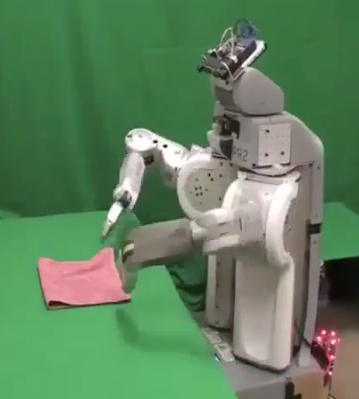
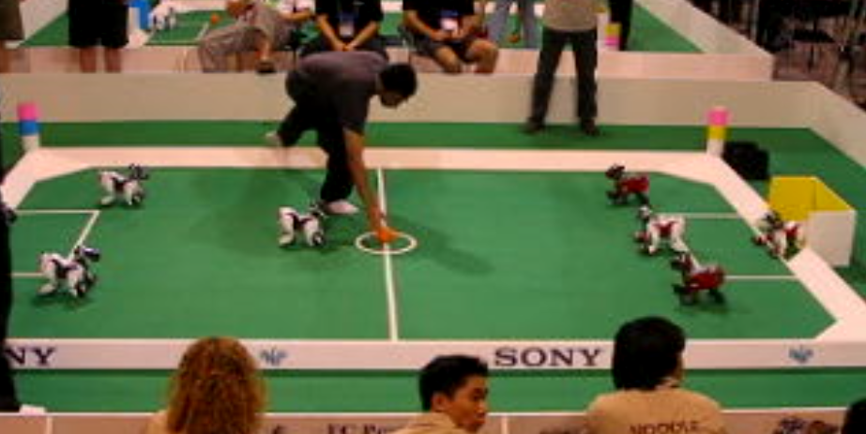
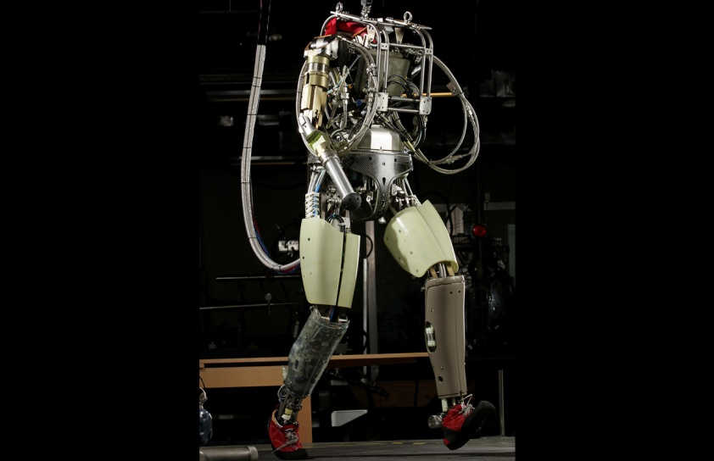
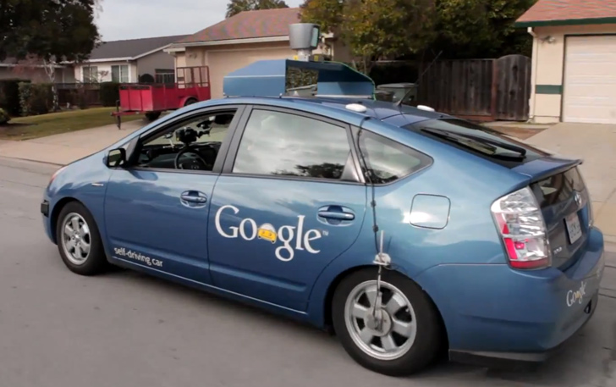
Robotics
Demo 1: ROBOTICS – soccer.avi
Demo 4: ROBOTICS – laundry.avi
Demo 2: ROBOTICS – soccer2.avi
Demo 5: ROBOTICS – petman.avi
Demo 3: ROBOTICS – gcar.avi
Robotics
Part mech. eng.
Part AI
Reality much
harder than
simulations!
Technologies
Vehicles
Rescue
Soccer!
Lots of automation…
In this class:
We ignore mechanical aspects
Methods for planning
Methods for control
Images from UC Berkeley, Boston Dynamics, RoboCup, Google

Slide 34
Logic
Logical systems
Theorem provers
NASA fault diagnosis
Question answering
Methods:
Deduction systems
Constraint satisfaction
Satisfiability solvers (huge advances!)
Image from Bart Selman
Notes:
Lets go to another area: Logics
What you see on the right-hand side is the first theorem prove made by the computer.

Slide 35
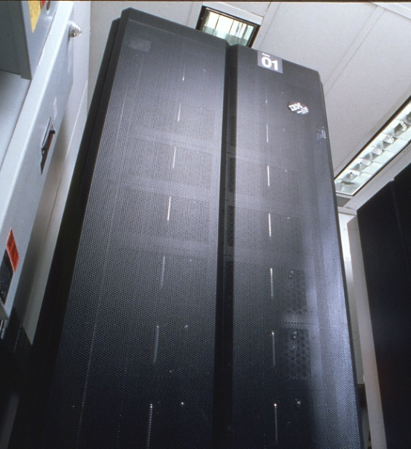
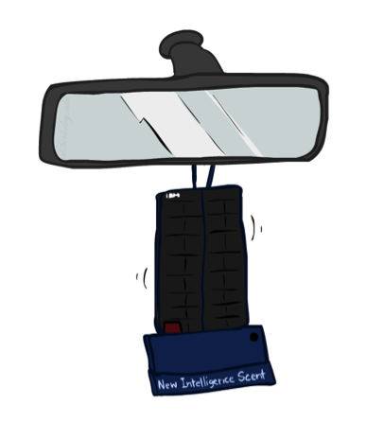
Game Playing
Classic Moment: May, '97: Deep Blue vs. Kasparov
First match won against world champion
“Intelligent creative” play
200 million board positions per second
Humans understood 99.9 of Deep Blue's moves
Can do about the same now with a PC cluster
Open question:
How does human cognition deal with the
search space explosion of chess?
Or: how can humans compete with computers at all??
1996: Kasparov Beats Deep Blue
“I could feel --- I could smell --- a new kind of intelligence across the table.”
1997: Deep Blue Beats Kasparov
“Deep Blue hasn't proven anything.”
Huge game-playing advances recently, e.g. in Go!
Text from Bart Selman, image from IBM’s Deep Blue pages
Notes:
Yeah, Kasparov comment probably says more about humans than about computers

Slide 36

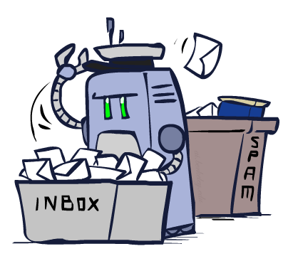
Decision Making
Applied AI involves many kinds of automation
Scheduling, e.g. airline routing, military
Route planning, e.g. Google maps
Medical diagnosis
Web search engines
Spam classifiers
Automated help desks
Fraud detection
Product recommendations
… Lots more!
Notes:
All applications can be thought of as decision making or useful sub-components of decision making

Slide 37
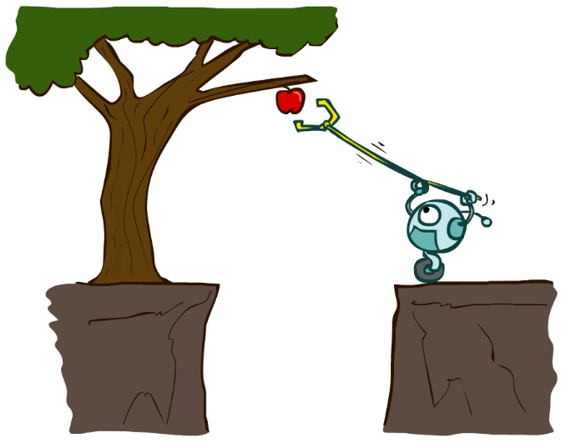
Designing Rational Agents
An agent is an entity that perceives and acts.
A rational agent selects actions that maximize its (expected) utility.
Characteristics of the percepts, environment, and action space dictate techniques for selecting rational actions
This course is about:
General AI techniques for a variety of problem types
Learning to recognize when and how a new problem can be solved with an existing technique
Sensors
Agent
Percepts
Environment
?
Actuators
Actions
Notes:
What is the unified formalism of this course?
The unified formalism of this course is to design a rational agents.
What is that mean??
An agent is an entity that perceives and acts. So an agent is something that perceives which means get some inputs and act which means it can generate an outputs. For example: you perceive a search query and then you generate a web page you suggest for somebody to look at.
Maybe something physical: you perceive the word you want an apple, then you generate an action in term of how to get an apple.
The agent consists of sensors and actuators. Agents interact with environments through sensors and actuators.
An agent is anything that can be viewed as perceiving its environment through sensors and
acting upon that environment through actuators.
A human agent has eyes, ears, and other organs for sensors and hands, legs, vocal tract, and so
on for actuators.
A robotic agent might have cameras and infrared range finders for sensors
and various motors for actuators.
A software agent receives keystrokes, file contents, and network packets as sensory inputs and acts on the environment by displaying on the screen, writing files, and sending network packets.

Slide 38
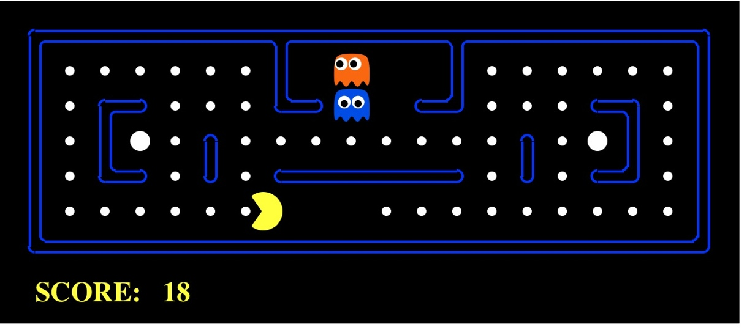
Pac-Man as an Agent
Agent
Environment
Sensors
Percepts
?
Actuators
Actions
Pac-Man is a registered trademark of Namco-Bandai Games, used here for educational purposes
Demo1: pacman-l1.mp4 or L1D2
Notes:
L1D2 =
python demos.py
Select Lecture 1 → select demo 2
One question here: what does it mean here to maximize your expected utilities? Eating the dots give you a point, eating the ghost give you a bonus.
So utility corresponds to the points you received here.

Slide 39
Course Topics
Part I: Making Decisions
Fast search / planning
Constraint satisfaction
Adversarial and uncertain search
Part II: Reasoning under Uncertainty
Bayes’ nets
Decision theory
Machine learning
Throughout: Applications
Natural language, vision, robotics, games, …

